Slide 1
Physics in the Nature Park
Linking light and heat with everyday school experiences

Slide 2
Overview
These slides are an accompanying resource to the KS3 guidance ‘Teaching light and heat topics through everyday experiences’.
The slides relate to different concepts, ideas and activities discussed in the guidance.
They are intended to be embedded within your own schemes of work to supports lessons on light transmission, absorption, and reflection; energy transfer by light; and human-driven CO₂ emissions and their impact on the climate.
They link Physics concepts to learners' everyday experiences in their school grounds.

Slide 3
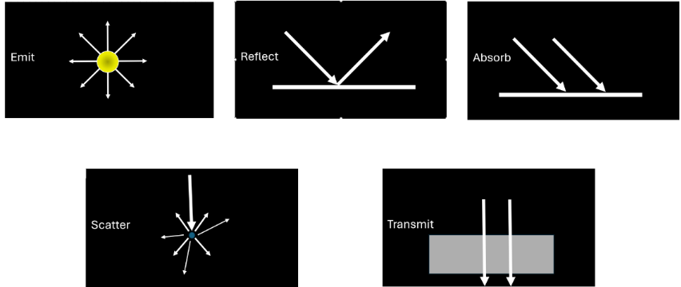
Heating effects of light and infrared interacting with materials and surfaces

Slide 4
Discussion questions for school grounds images
Use these questions to discuss the impact of surface type and colour on temperatures in the school grounds.
How does surface colour affect temperature in sunlight, and why?
How do dark surfaces on buildings and paving affect the surroundings during sunshine?
What impact could dark roofs, walls or doors have on temperatures inside buildings?
How can design and vegetation help reduce the demand for air conditioning?

Slide 5

Infrared scale
Highest surface temperature
Lowest surface temperature​
White indicates the highest surface temperature in a frame and dark blue the lowest.

Slide 6
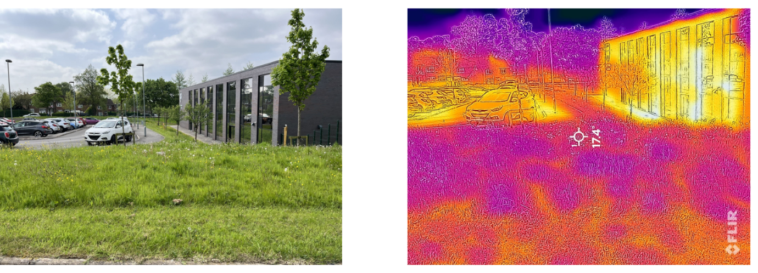
Example school ground images
Co-op Academy Manchester, May 2024

Slide 7
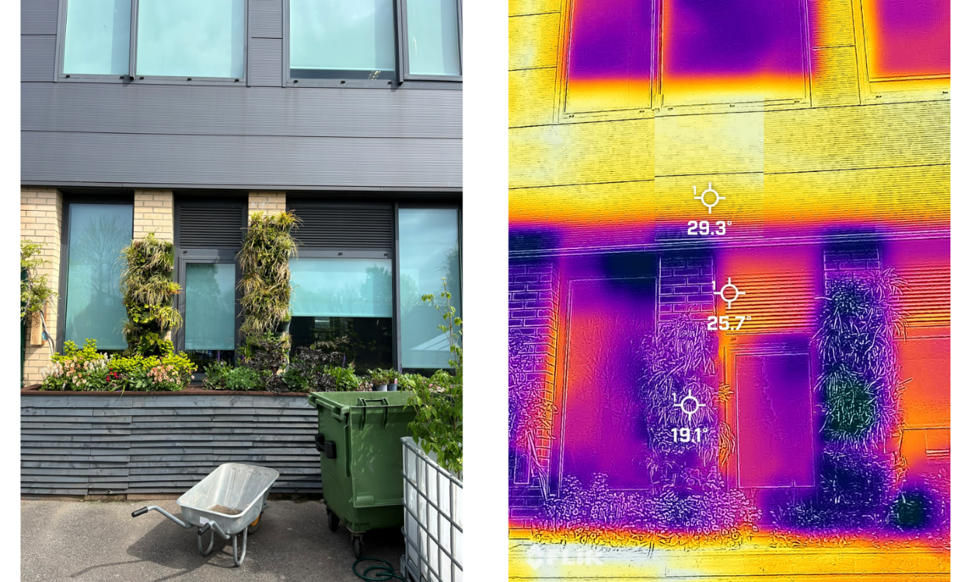
Example school ground images
Co-op Academy Manchester, May 2024

Slide 8
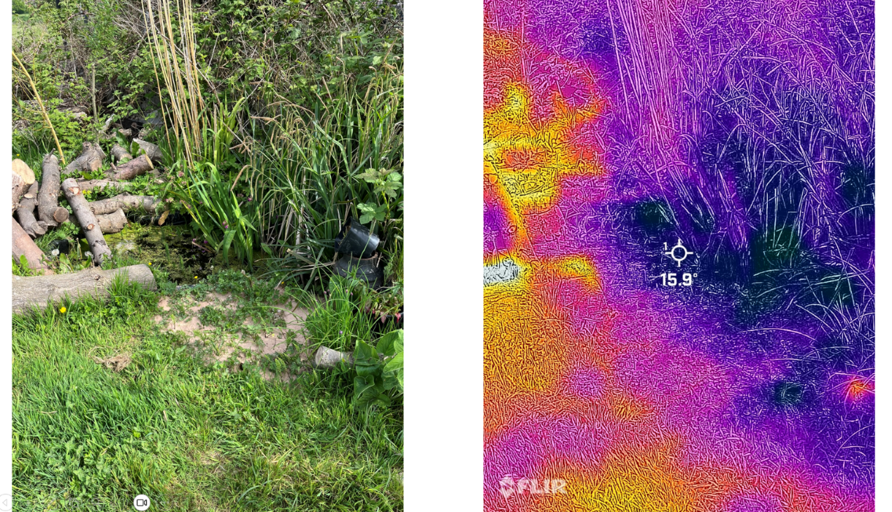
Example school ground images
Co-op Academy Manchester, May 2024

Slide 9
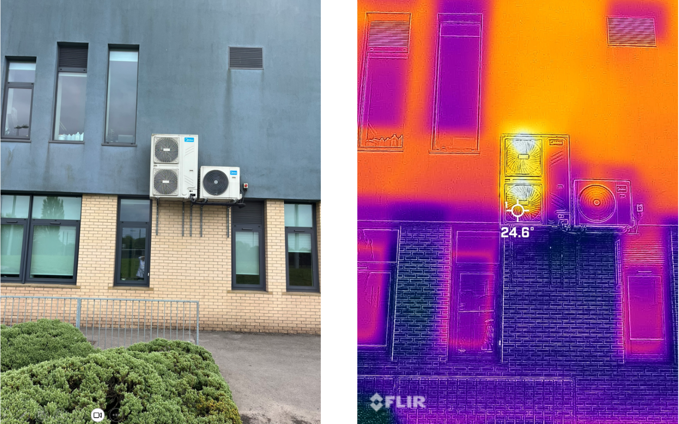
Example school ground images
Co-op Academy, Manchester, May 2024

Slide 10
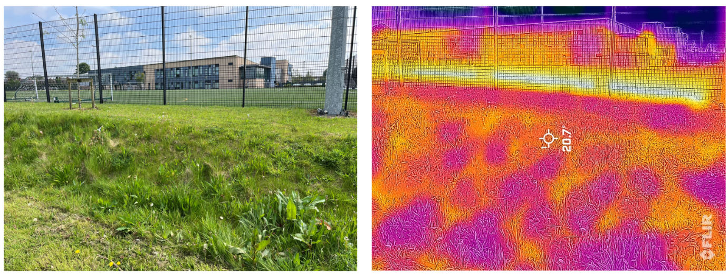
Example school ground images
Co-op Academy, Manchester, May 2024

Slide 11
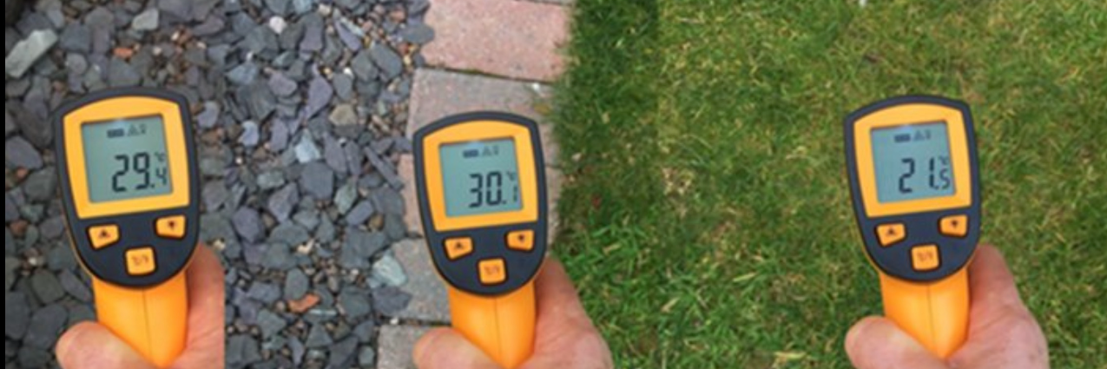
Example school ground images

Slide 12
What is happening in the images?
Dark surfaces absorb more solar radiation, heating up and emitting more thermal energy
Pale surfaces absorb less radiation, stay cooler, and warm the air less
Co-op Academy Manchester, May 2024

Slide 13




Surfaces and sunshine
Which shirt would likely be most uncomfortable in a heatwave?
What happens to solar radiation after it hits each T-shirt?

Slide 14

Learning from architecture
How can traditional Mediterranean and Arabic building designs teach us to keep buildings cool in hot sun?
Santorini, Greece, CC0​

Slide 15



Who is correct and why?
Sunlight warms dark surfaces
Sunlight warms the air
It is dark surfaces which heat the air
Ash
Kiran
Em and Kiran are correct. Ash is incorrect.
Em

Slide 16
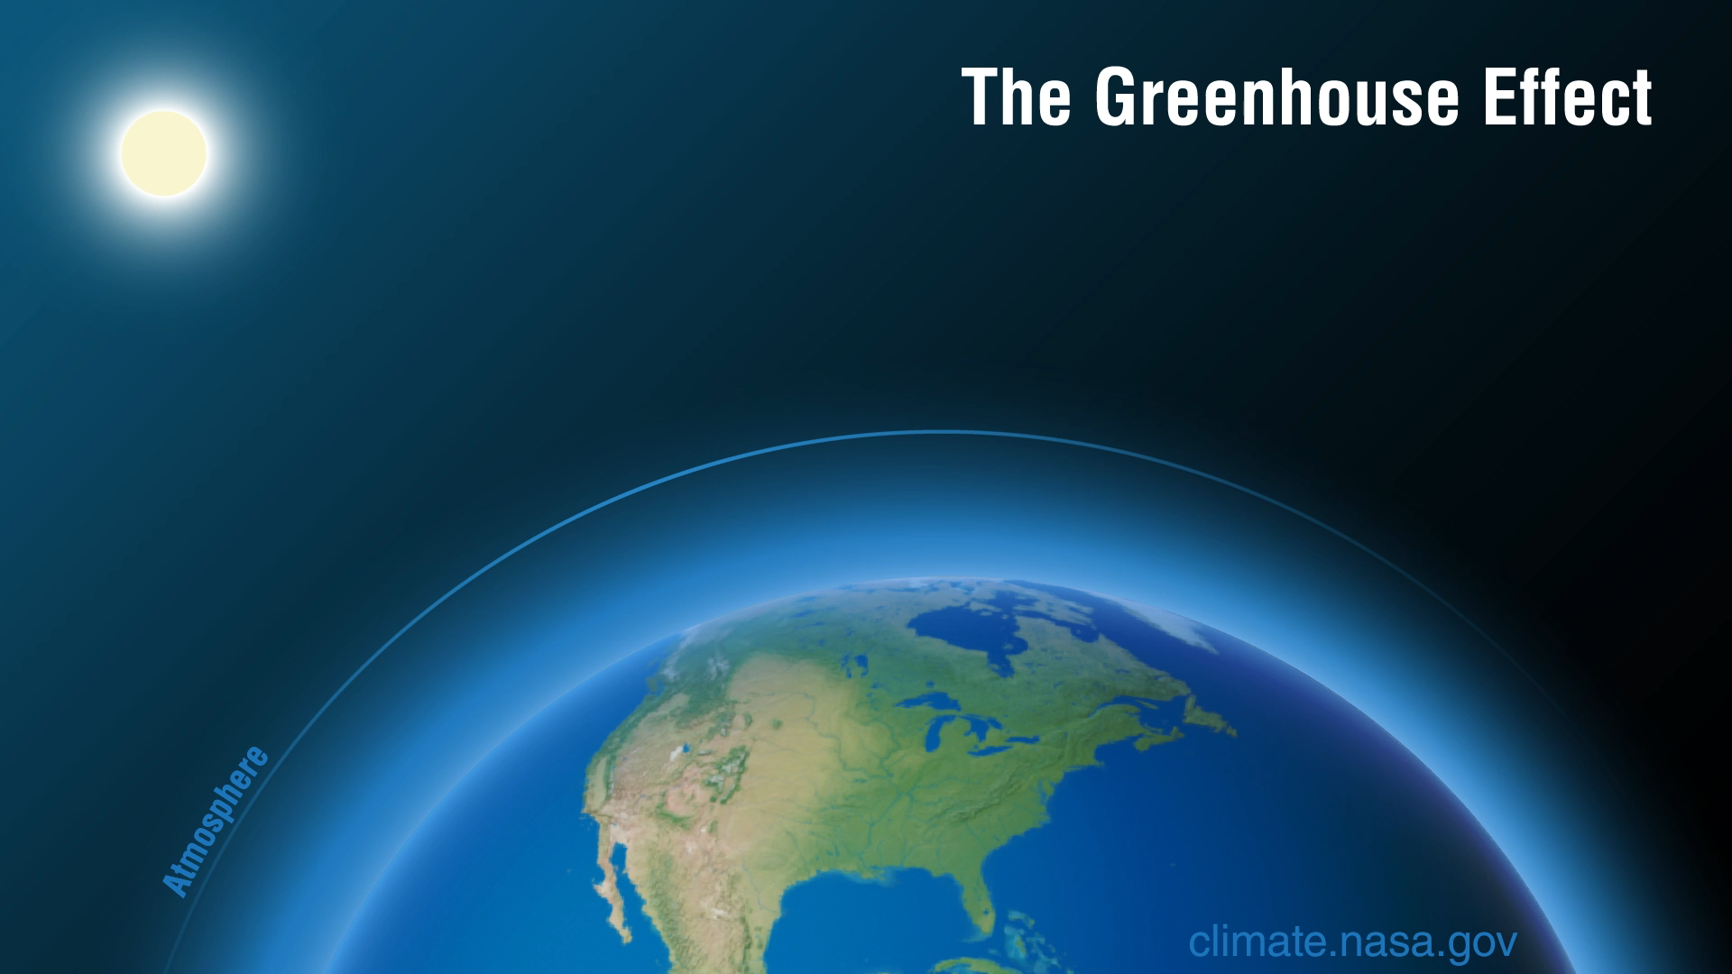
Graphic: The greenhouse effect
Credit - NASA-JPL/Caltech

Slide 17
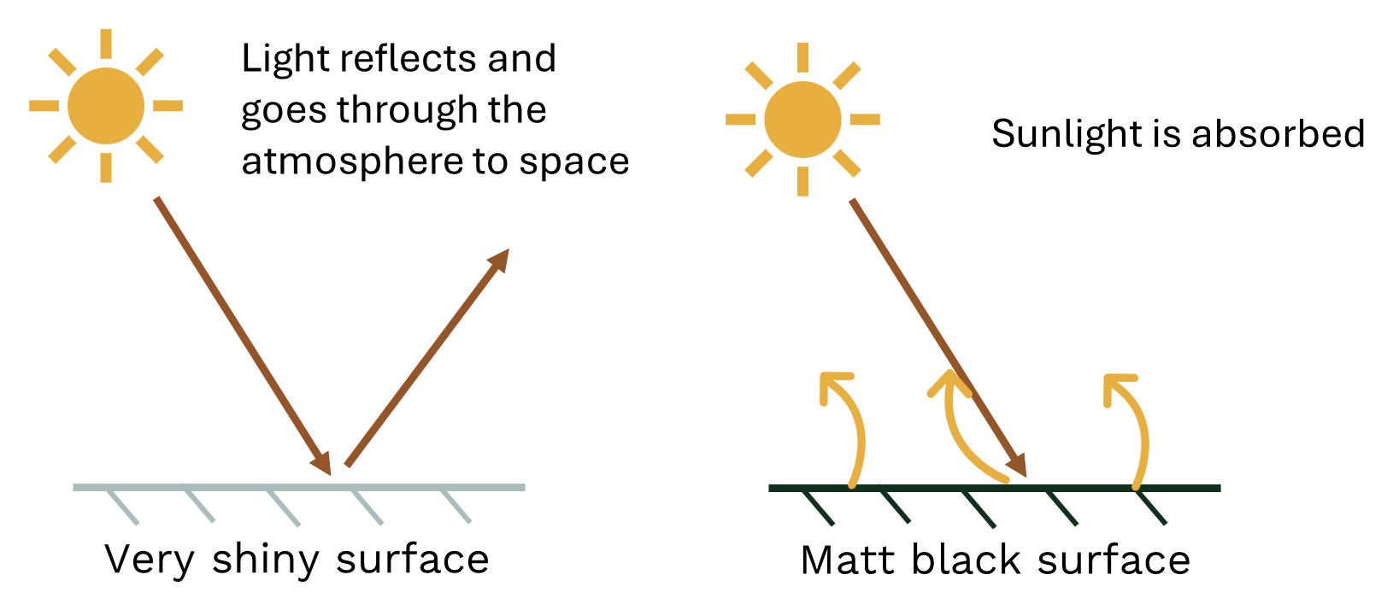
Surface colour – Predicting what happens to air temperature
No heating of air.
The surface is heated.
The squiggly arrows show that the air around the surface is heated.
The air is therefore heated.

Slide 18
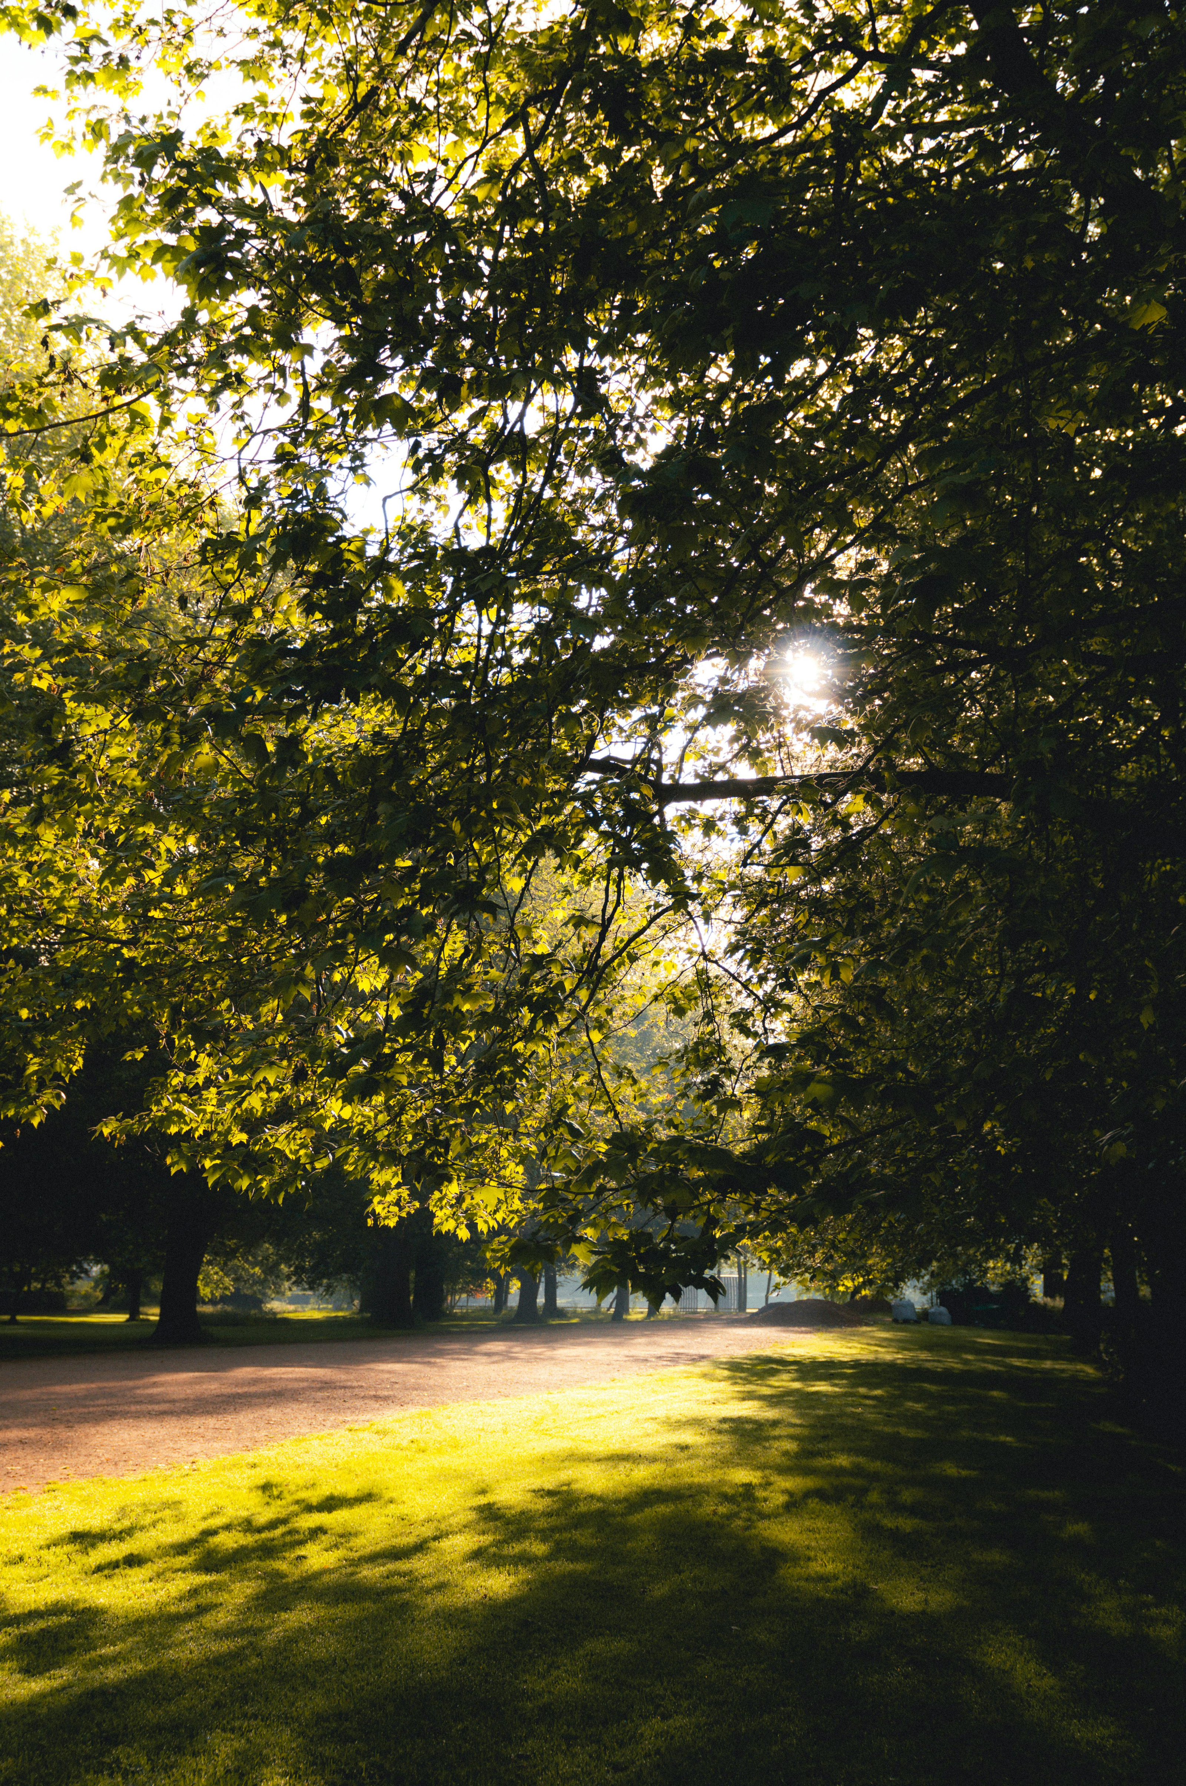
Air temperature
Why is the temperature in the shade much lower than in full sun?
Why is the air often cool on a sunny summer morning, even though the sun feels warm on your skin?
Why is the hottest time of a sunny summer’s day usually mid-to-late afternoon, not midday when the sun is shining most directly?

Slide 19
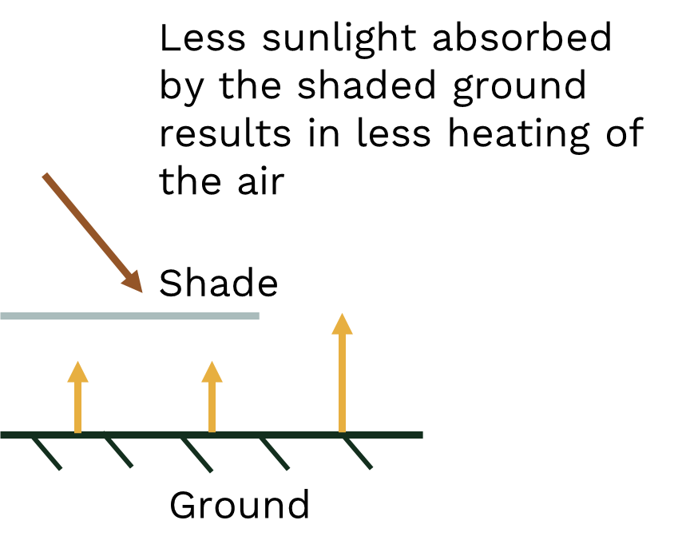
Explanation
The sun heats the ground. It takes a while for the ground to become warm as there is a delay between the delivery of powerful solar radiation and the heating of the air. This is because solar radiation heats the earth’s surface, which in turn heats the air. This takes time.

